Slide 1
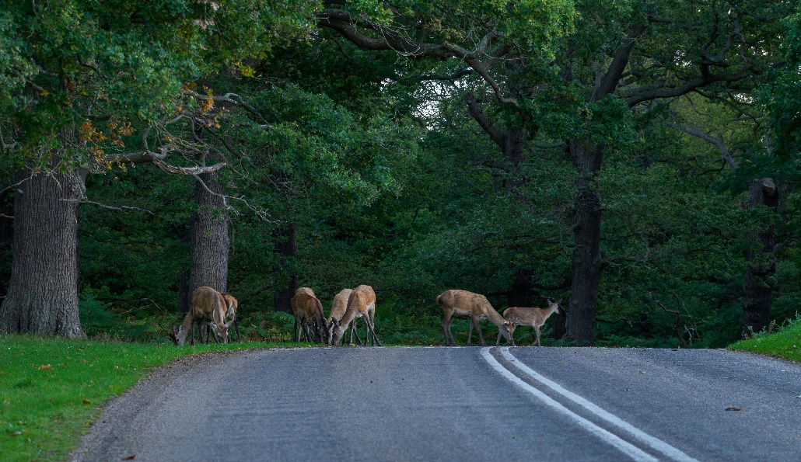

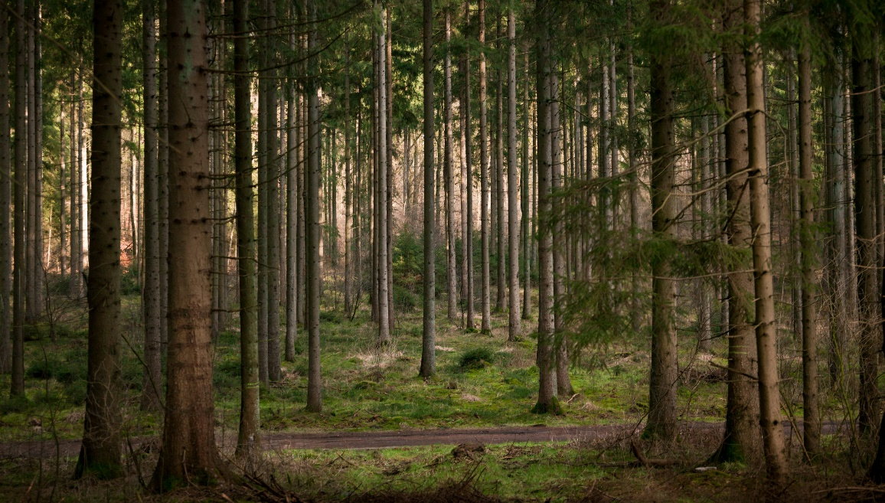
National Parks Portal
The Website National Parks Portal Is Designed For The Information , Research , Top 5 National Parks In Pakistan To Explore The Animals , Birds , Facilities & Nature. It’s Specially For Those Who Love To Hiking & Exploring Nature
. The Facilities Buttons Are Available In The Website For Every Moments For Example If You Want To Check Out The Animals , Birds The Buttons Are Available Click The Button & Explore

Slide 2
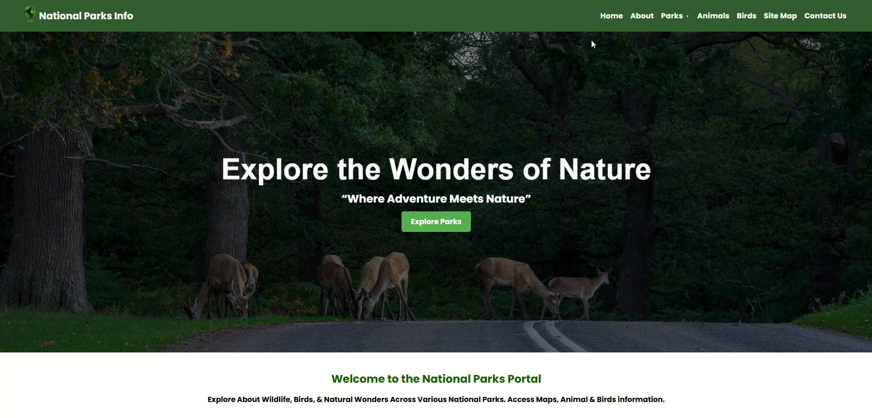

Slide 3
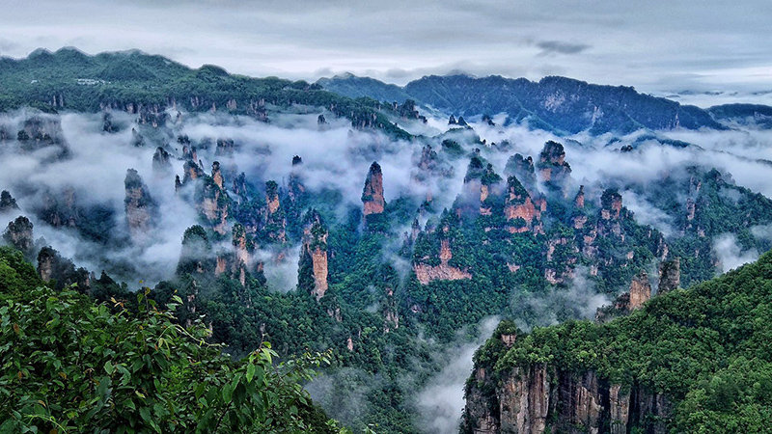
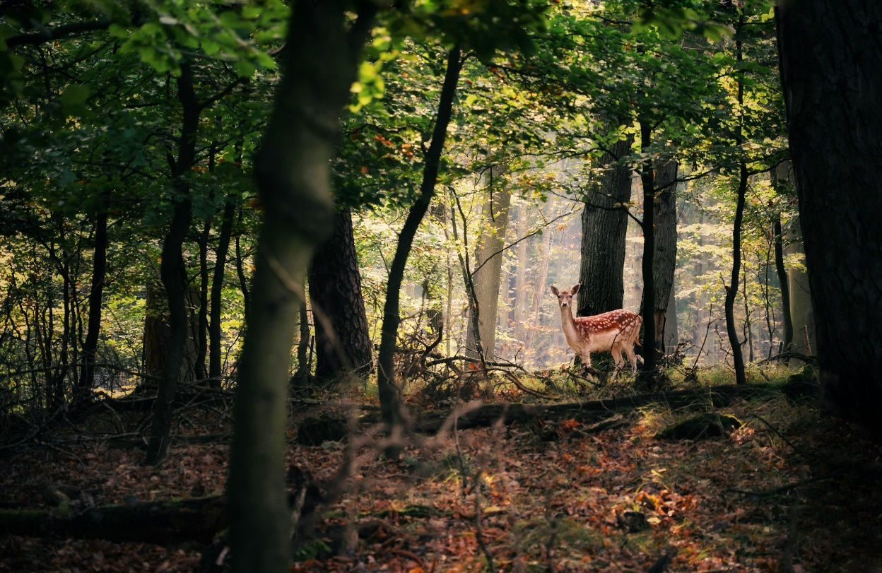
The End

